Slide 1
Analysis of World Cup Finals

Slide 2
Outline
Project Understanding
World Cup History
Data Understanding
How to collect the data
Data Manipulation
Data Cleaning
Feature Selection
Missing Values Handling
Discretization and Normalization
Data Visualization
Modelling
Classification of matches
Regression of matches’ scores
Association Rule Learning
Conclusion

Slide 3
Project Understanding
Domain is football.
Peak of Football Competitions
Held by FIFA
Why is World Cup Finals so important?
Viewer’s Perspective
Player’s Perspective
Nationalism

Slide 4
World Cup History

Slide 5
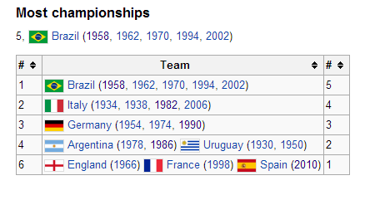
World Cup History
Most Successful countries

Slide 6
Project Understanding
Purpose of The Project
Try to estimate match results based on previous world cup finals’ mathces
Try to estimate match scores based on previous world cup finals’ matches’ scores
Try to find meanningfull rules
Figure out which attributes are more important on winning a match.

Slide 7
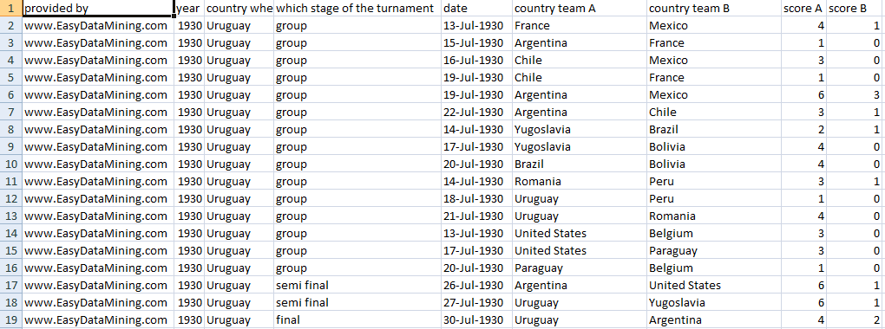
Data Understanding
No available data in the Internet!
No available data organization for analysis.
The very best data I could found

Slide 8
Data Understanding
The data is far from being enough!
New attributes introduced
Population, Average Income, Host Information, PastSuccess, CurrentForm, FIFA rank, CurrentClubForm, Match Status
Information gathered from FIFA, UEFA, CONMEBOL, CAF, AFC
Information is not enough, needs revision

Slide 9
Population
Larger population may indicate better national team performance
Larger means larger talent pool to choose from

Slide 10
Average Income
How does average income affects national team performance?
Football is the poor’s sport or riche’s ?

Slide 11
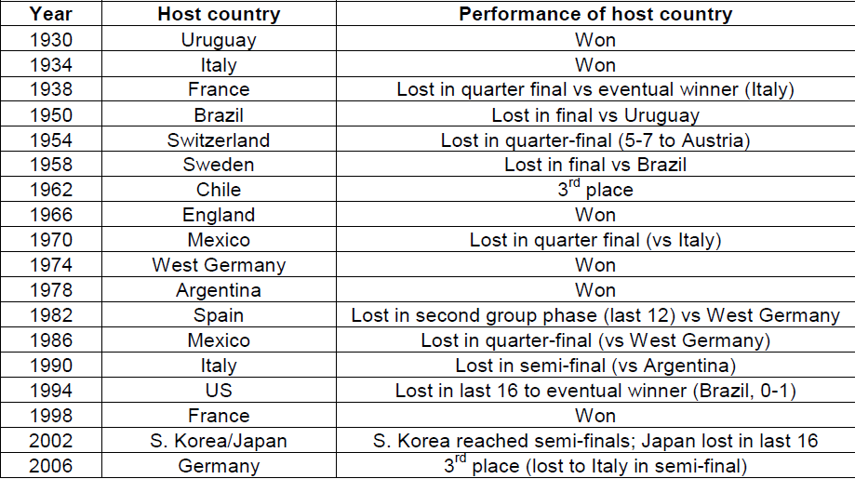
Host
Does hosting affect country’s performance ?
In fact, it does

Slide 12
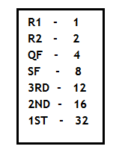
Past Success
Reflects the world cup achievements of a country until specified year.
It brings “BIG TEAM” identity.
Points Calculation Table

Slide 13
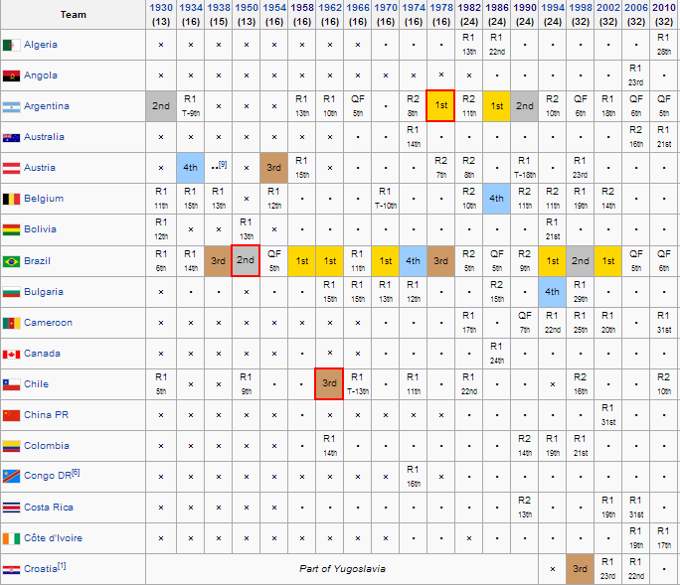
Past Success
World Cup History Table

Slide 14
Current Form
Reflects the achivement in last world cup final and the other biggest associated competition’s achivement ( e.g. European Cup, Copa America, Africans Cup, Asian Cup)
Points calculated similar to past success, but each competition has different weights

Slide 15
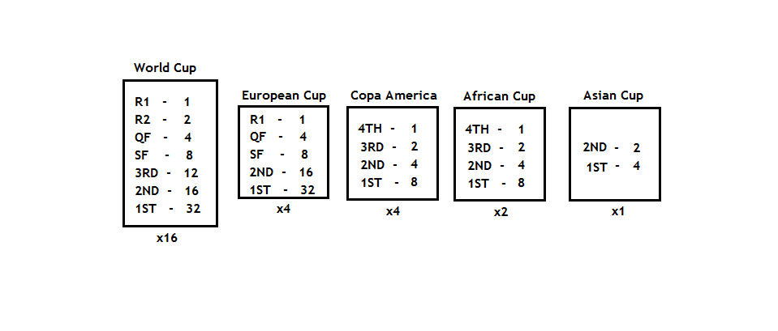
Current Form
Calculation Table

Slide 16
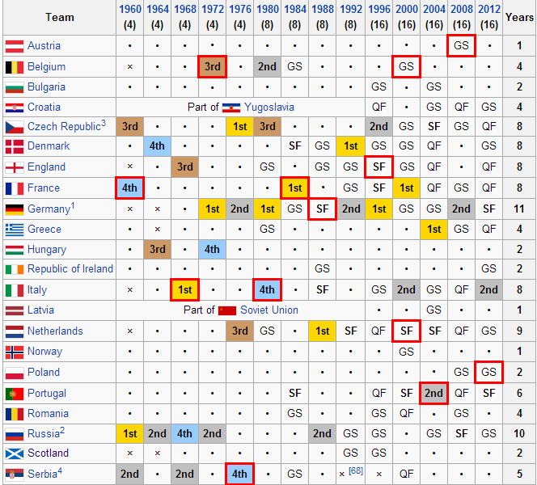
Current Form
European Cup Table

Slide 17
Club Form
Reflects the form of the clubs in a particular country
Top 25 clubs according to FIFA found
Then for each club, points assigned to corresponding country
Based on Champions League, Copa Libertadores, UEFA Cup, League Success

Slide 18
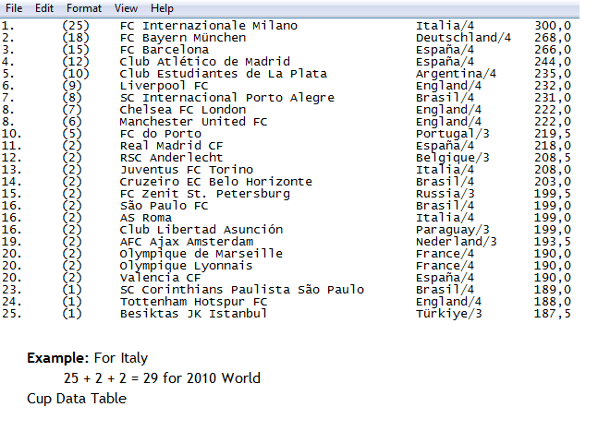
Club Form
Calculation Table

Slide 19
FIFA Rank
Reflects the success of each country in last five years along with its club success, league success, international success in all friendly and official qualification and finals matches
Lowest rank means most successful country

Slide 20
Data Manipulation- Cleaning
USA vs United States
No longer existing countries
Soviet Union
Yugoslavia
Missing Values
Before 1991, FIFA Ranks and Club Forms Missing
Thus, data after 1994 World Cup Final is used

Slide 21
Feature Selection
# attributes are low
No algorithm used
Selection done using expert knowledge and some statistical tools

Slide 22
Population vs Success

Slide 23
GDP vs Success

Slide 24
Feature Selection
Remove population and GDP
13 attributes left

Slide 25
Missing Values Handling
Two different tables
One with no missing value handling operation
Simply remove rows with missing values
The other with using average for missing values

Slide 26
Discretization - Normalization
Discretization is done for decision tree and bayesian classifiers
Normalization is done for SVM, Neural Network and k-NN classifiers

Slide 27
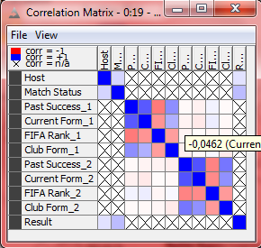
Data Visualization
Correlation Matrix

Slide 28
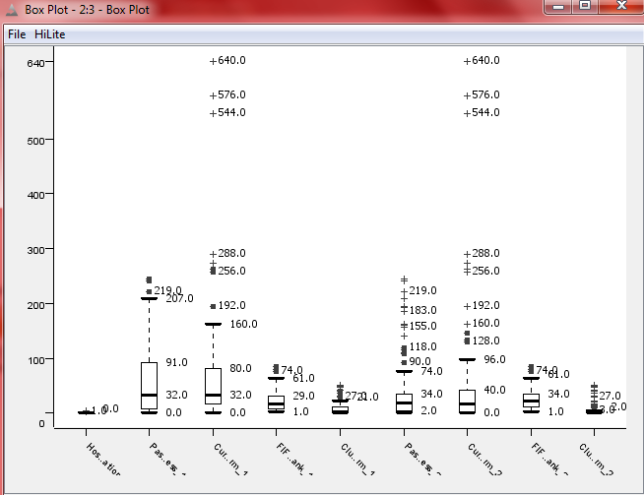
Data Visualization
Box Plot

Slide 29
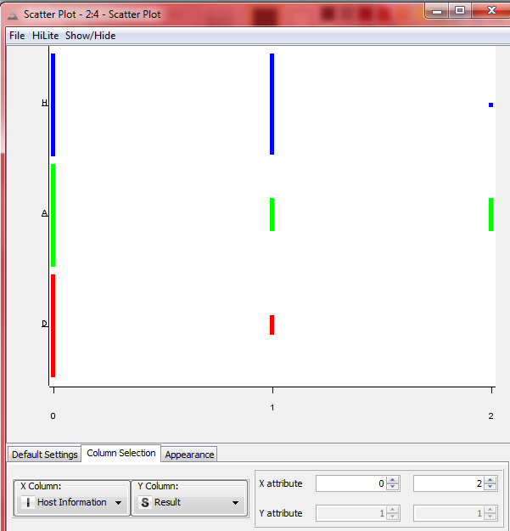
Data Visualization
Scatter Plot: Host vs Result

Slide 30
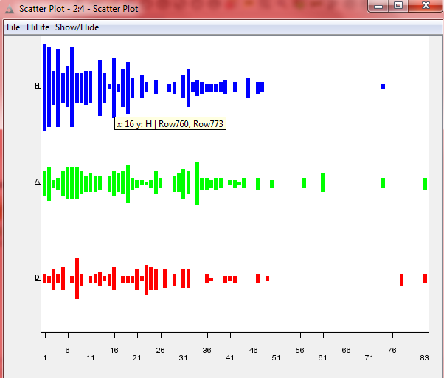
Data Visualization
Scatter Plot: FIFA Rank1 vs Result

Slide 31
Modelling
For modelling each classiffier is tested with following different parameters
5 Fold Cross Validation
10 Fold Cross Validation
Random Sampling
Stratified Sampling
Also discretization and normalization are done before classification

Slide 32
KNIME - Modelling

Slide 33
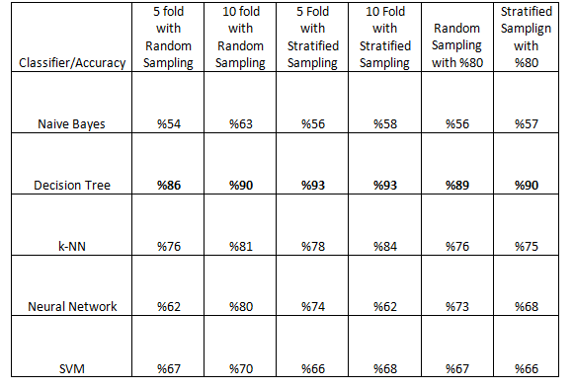
Modelling
Results of Modelling

Slide 34
Modelling
Decision Tree gives best result!
K-NN gives second best, while others have poor classification
Stratified Sampling is generally better than random sampling
10 fold is generally better than 5 fold

Slide 35
Decision Tree

Slide 36
Decision Tree
Tree model indicates the order of attribute importance as follows:
1- Club Form
2- Current Form
3- Past Success
4- Host Information

Slide 37
Regression Tree
For Regression, regression tree is used in WEKA
The mean absolute error for score1 is 0.43
The mean absolute error for score2 is 0.38
The errors are high as expected.

Slide 38
Association Rules
Rules are extracted using WEKA and Knime after discretization of the data
Current Form_2='(-inf-88]' Result=H 439 ==> Club Form_2='(-inf-15.5]' 439 conf:(1) (WEKA)
FIFA Rank_1='(-inf-20.5]' Result=H 374 ==> Club Form_2='(-inf-15.5]' 371 conf:(0.99) (WEKA)
Current Form_1='(26-inf)' Result=H 359 ==> Club Form_2='(-inf-15.5]' 354 conf:(0.99) (WEKA)
0.31369426751592355,0.6194968553459119,1.1970585389453312,"0-10_Past Success_2","<---","[H_Result]“ (KNIME)
0.40605095541401276,0.8018867924528302,1.1215699457914863,"0_Club Form_2","<---","[H_Result]“ (KNIME)

Slide 39
Conclusion
It is hard to collect data manually!
The attributes I come up with are better than FIFA rank, so be careful FIFA
To sum up, club form is the most important factor for a country to be successful in World Cup Finals
After that, current form, past success and host information come

Slide 40
Golden Generation

Slide 41
Golden Generation

Slide 42
Future Work
The more number of players from a same club in a particular country, the more likely that country will be successful in World Cup Finals
Another data analysis would be on that issue

Slide 43
THANK YOU FOR LISTENING.
ANY QUESTIONS?

